Slide 1


ESD Lab - FDP
On behalf of SPPU, in Collaboration with Army Institute Of technology
22-26 June 2020
Intellectual Property Of CopperCloud IOTech Pvt Ltd

Slide 2
Objectives Of This Session
After this programme, the attending faculty:
will understand the drivers behind introduction of the ESD Lab for SE E&TC
will be able to conduct and supervise the lab assignments, as described in the syllabus
will have access to standardized Instructor's Manual, teaching aids and tools relevant to conduct of the listed practicals
Intellectual Property Of CopperCloud IOTech Pvt Ltd

Slide 3
For Best Results …
Lets make it interactive, to the extent that this remote format allows
Post your questions in the chat box, as and when you have them. We will have Q&A segments as well every day
Request everyone to remain off-video and on mute, except if you are speaking (to reduce audio conflicts and to save bandwidth for everyone)
Please share your expertise with this forum
Practice hands-on in self-paced manner – followed by Q&A
Intellectual Property Of CopperCloud IOTech Pvt Ltd

Slide 4
About Us …
CopperCloud IOTech is a start-up in Internet of Things (IoT) space, established in 2018
Primarily into two fields:
Industrial Automation for MSME using IoT
Bringing practical IoT Education & Industry exposure to Institutes
Internships for at TE level from 6 Institutes, hiring experiences, deep engagements with 7 Institutes in Maharashtra
Academic Excellence Council, IQAC, and Adjunct Faculty at AIT
* We bring to you perspective of the final beneficiary of your efforts *
Intellectual Property Of CopperCloud IOTech Pvt Ltd

Slide 5
Let’s begin …
Intellectual Property Of CopperCloud IOTech Pvt Ltd

Slide 6
Drivers
Need more hands-on exposure to subjects such as:
basic electronic components
bread-boarding
circuit design
PCB design & assembly
new MCU platforms like Arduino
Do hands-on using industry-standard tools
Project-based, real-world work
ESD Lab Curriculum
*Our students have done these, but they haven’t done these enough to be proficient*
Intellectual Property Of CopperCloud IOTech Pvt Ltd

Slide 7
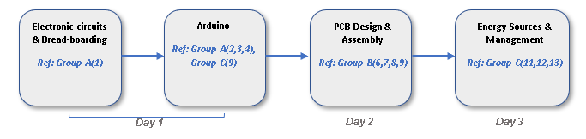
Logical Flow
Intellectual Property Of CopperCloud IOTech Pvt Ltd

Slide 8
Instructors’ Manual
Intellectual Property Of CopperCloud IOTech Pvt Ltd

Slide 9
Segment1: Electronic Circuits & Breadboarding
Day 1
Intellectual Property Of CopperCloud IOTech Pvt Ltd

Slide 10
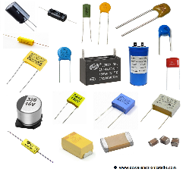
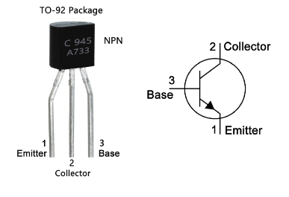
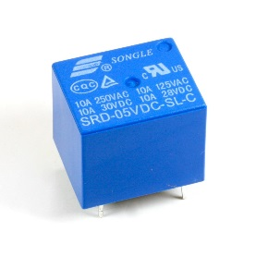
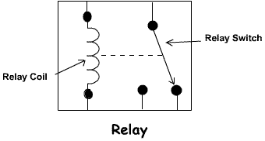
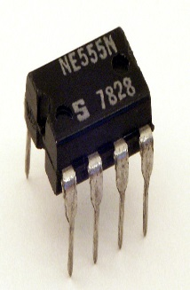
Basic Electronic Components
Segment #1
Intellectual Property Of CopperCloud IOTech Pvt Ltd

Slide 11
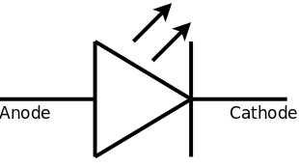
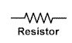
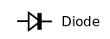
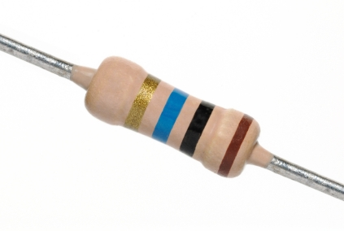
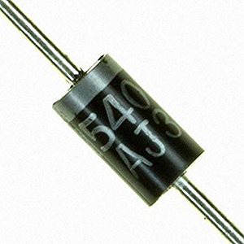
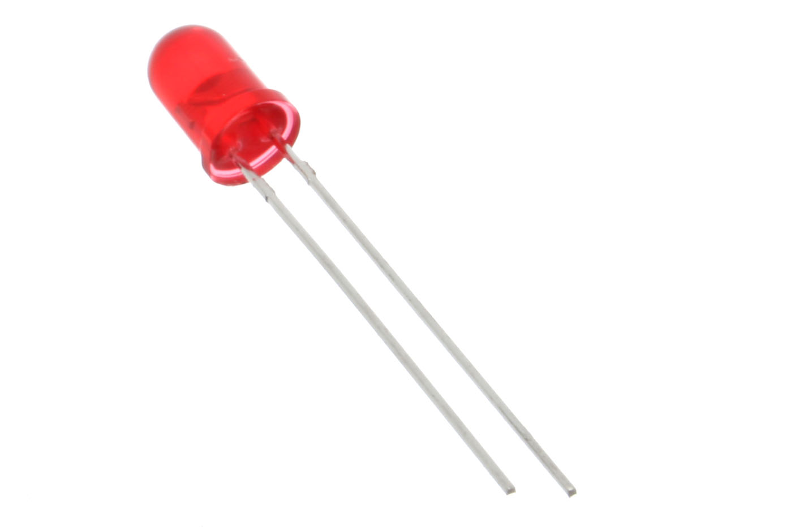
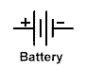
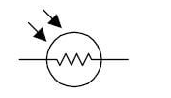
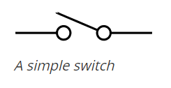
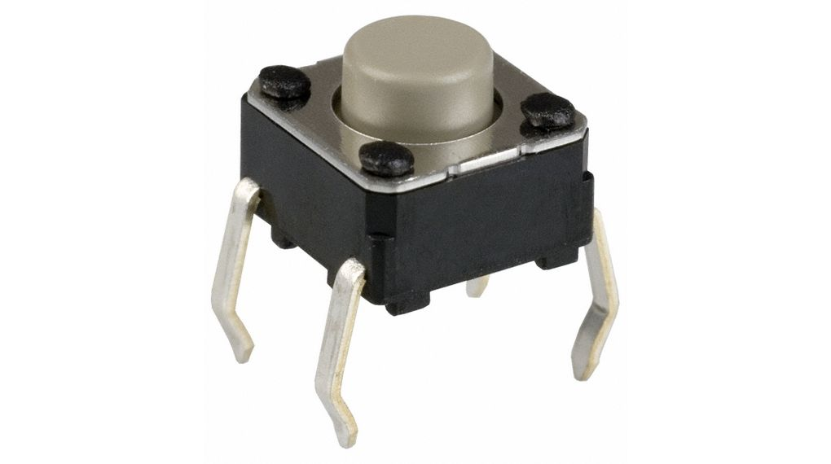
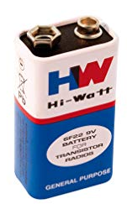
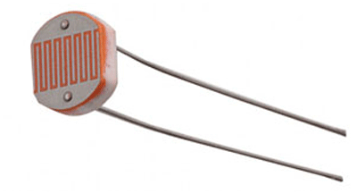
Basic Electronic Components
Segment #1
Intellectual Property Of CopperCloud IOTech Pvt Ltd

Slide 12
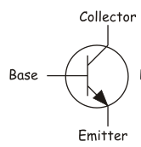
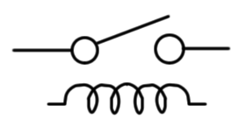

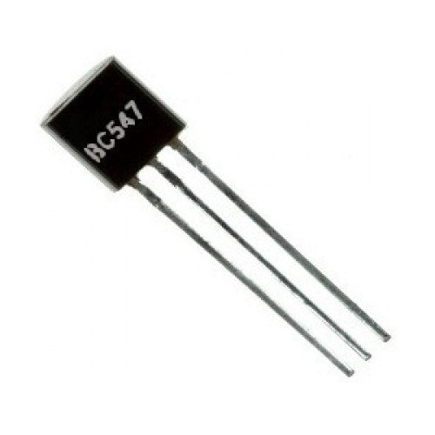
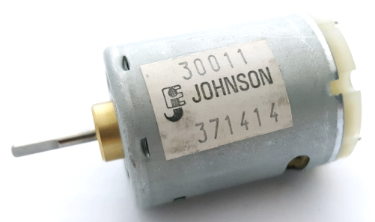
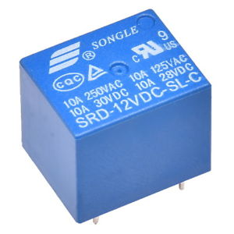
Basic Electronic Components
Segment #1
Intellectual Property Of CopperCloud IOTech Pvt Ltd

Slide 13
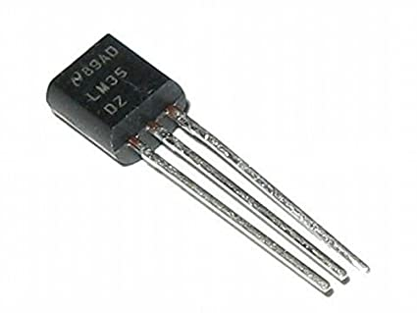
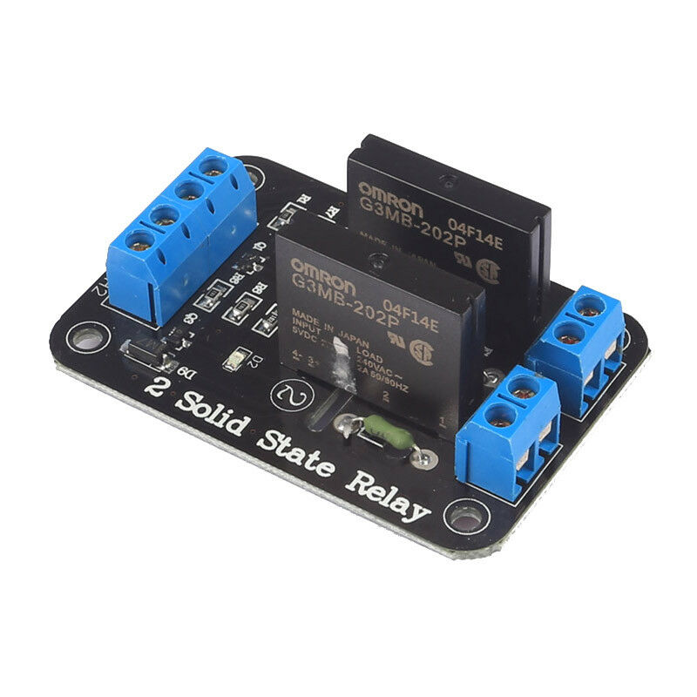
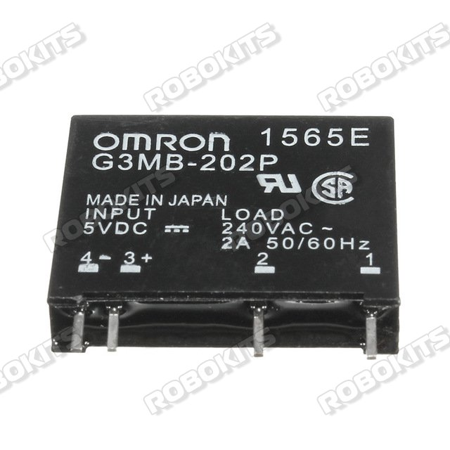
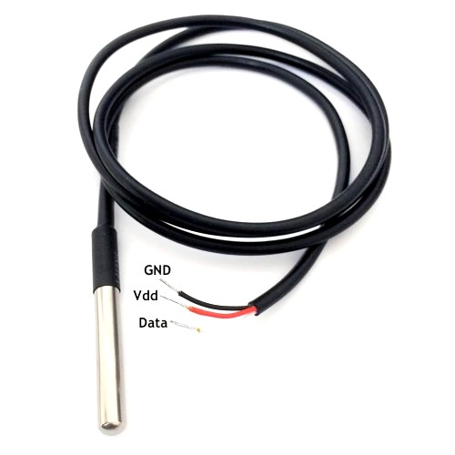
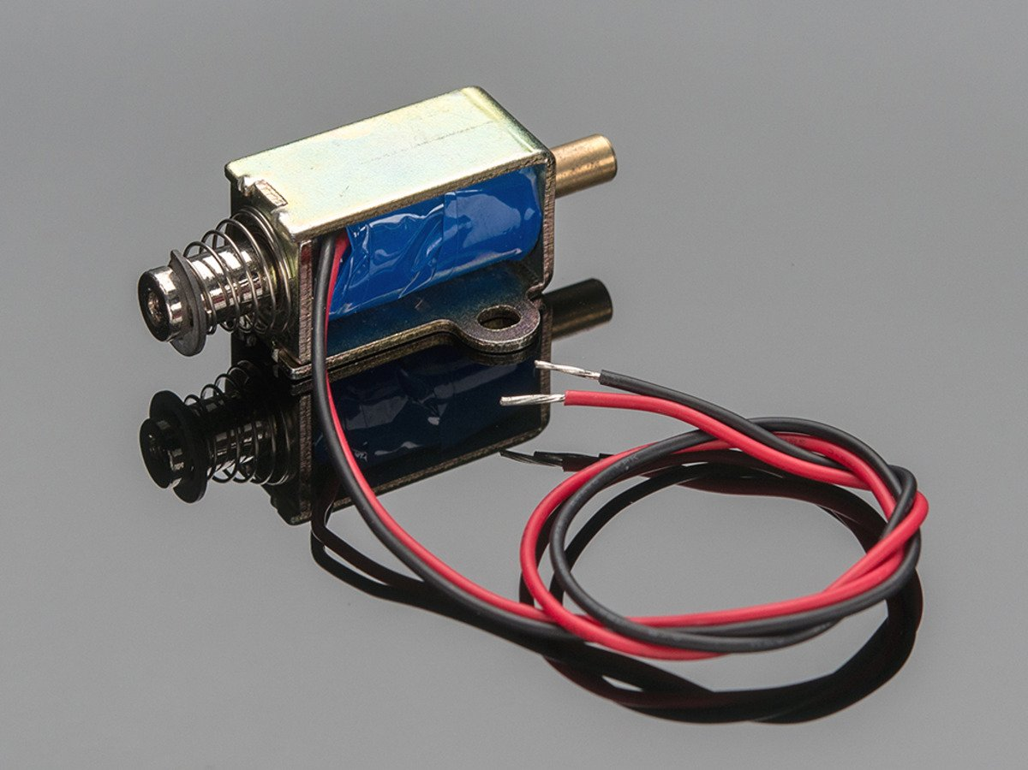
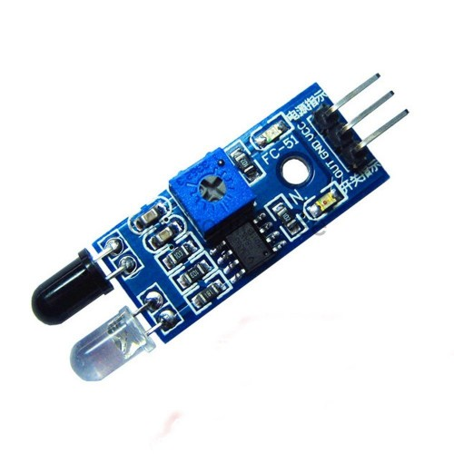
Basic Electronic Components
Segment #1
Actuators
Sensors
Intellectual Property Of CopperCloud IOTech Pvt Ltd

Slide 14
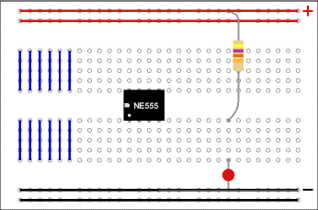
Bread-boarding
Segment #1
Intellectual Property Of CopperCloud IOTech Pvt Ltd

Slide 15
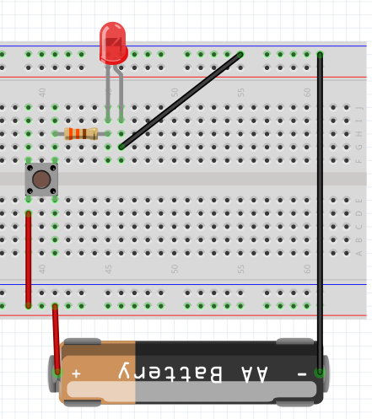
Segment #1
Bread-boarding
Intellectual Property Of CopperCloud IOTech Pvt Ltd

Slide 16
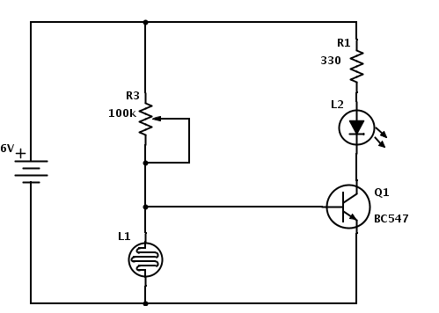
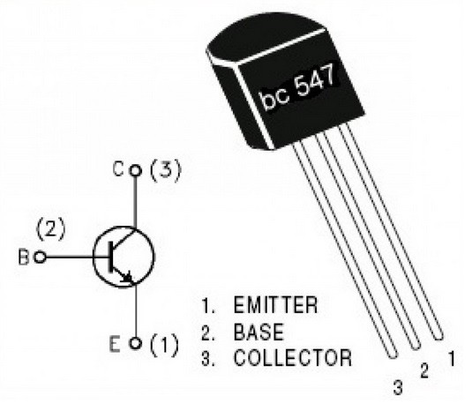
Segment #1
Assemble a basic circuit on Bread Board
330 Ohm
5.6K Ohm
9V
Intellectual Property Of CopperCloud IOTech Pvt Ltd

Slide 17
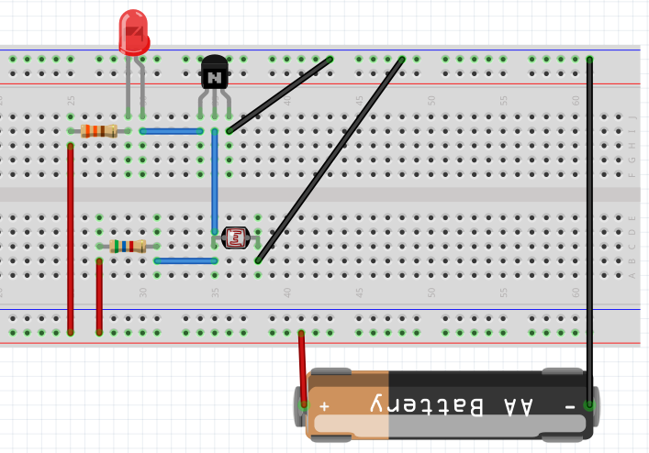
Segment #1
Assemble a basic circuit on Bread Board
Intellectual Property Of CopperCloud IOTech Pvt Ltd

Slide 18
Example Labs
Segment #1
Demo of lab/circuit/project, to show end-result
Detailed explanation of each step
Common pitfalls that students makes
Repeat steps for consolidating
Intellectual Property Of CopperCloud IOTech Pvt Ltd

Slide 19
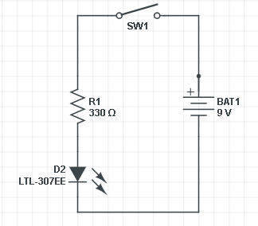
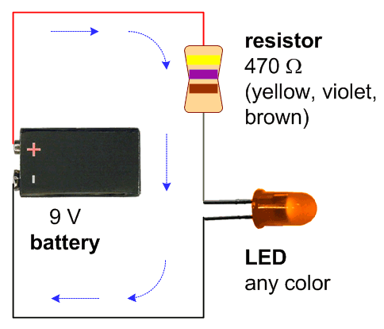
Example Lab1: Basic LED + Resistor Circuit
Segment #1
Intellectual Property Of CopperCloud IOTech Pvt Ltd

Slide 20
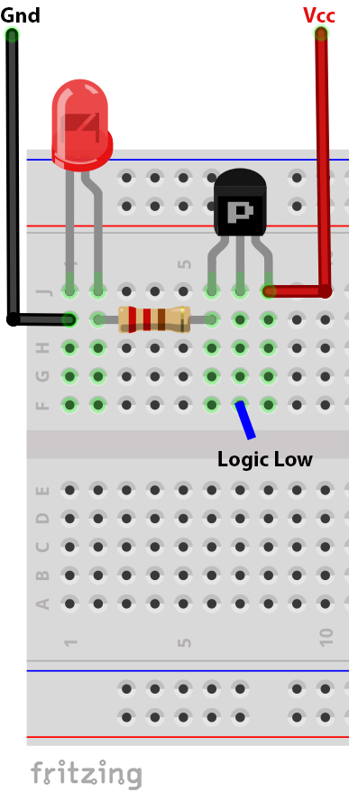
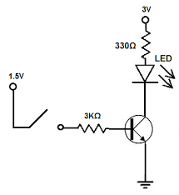
Example Lab2: Transistor-Driver for LED
Segment #1
Intellectual Property Of CopperCloud IOTech Pvt Ltd

Slide 21
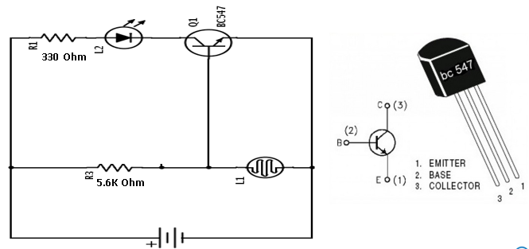
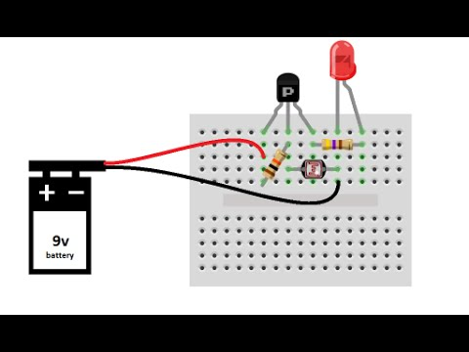
Example Lab3: Light/Dark Sensor Circuit
Segment #1
Intellectual Property Of CopperCloud IOTech Pvt Ltd

Slide 22
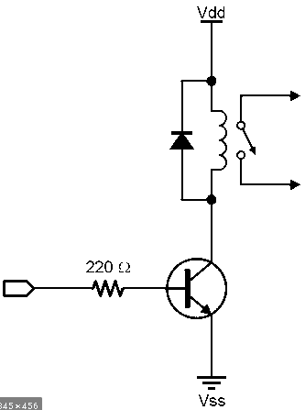
Example Lab4: Relay Driver Circuit
Segment #1
Intellectual Property Of CopperCloud IOTech Pvt Ltd

Slide 23
Segment2: Arduino & Related Labs
Day 1
Intellectual Property Of CopperCloud IOTech Pvt Ltd

Slide 24

Microcontrollers: Edge of Physical / Virtual World
Segment #2
μC bridge these 2 worlds
Intellectual Property Of CopperCloud IOTech Pvt Ltd

Slide 25

Arduino Basics
Segment #2
Intellectual Property Of CopperCloud IOTech Pvt Ltd

Slide 26

Arduino Basics
Segment #2
Intellectual Property Of CopperCloud IOTech Pvt Ltd

Slide 27
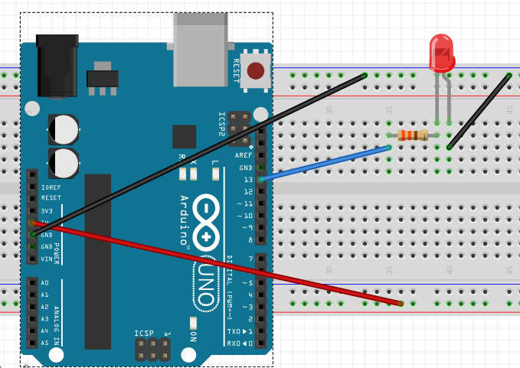
Arduino Basics
Segment #2
Intellectual Property Of CopperCloud IOTech Pvt Ltd

Slide 28
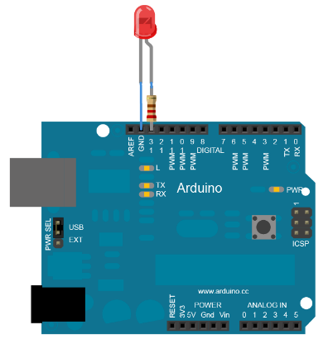
Example Lab5: Arduino with blinking LED
Segment #2
Intellectual Property Of CopperCloud IOTech Pvt Ltd

Slide 29
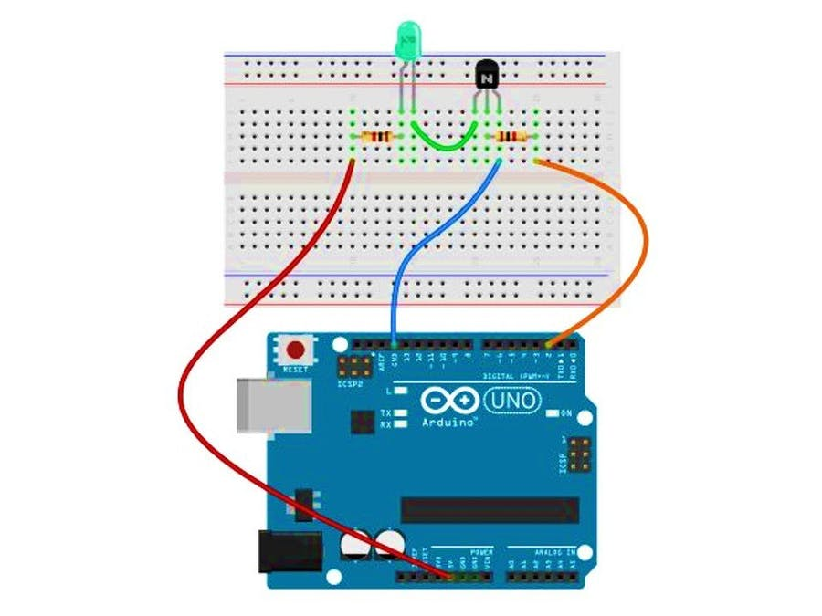
Example Lab6: Arduino with Transistor Driver for LED
Segment #2
PIN
Intellectual Property Of CopperCloud IOTech Pvt Ltd

Slide 30
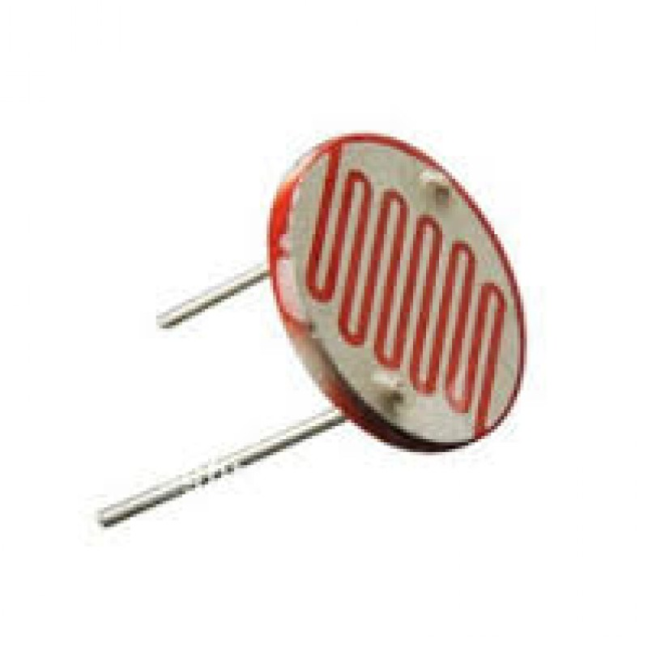
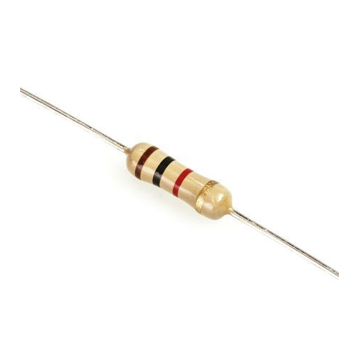

Example Lab7: Arduino Based Light/Dark Sensor
Segment #2
Pin A0
5.6 K Ohm
5V
Intellectual Property Of CopperCloud IOTech Pvt Ltd

Slide 31
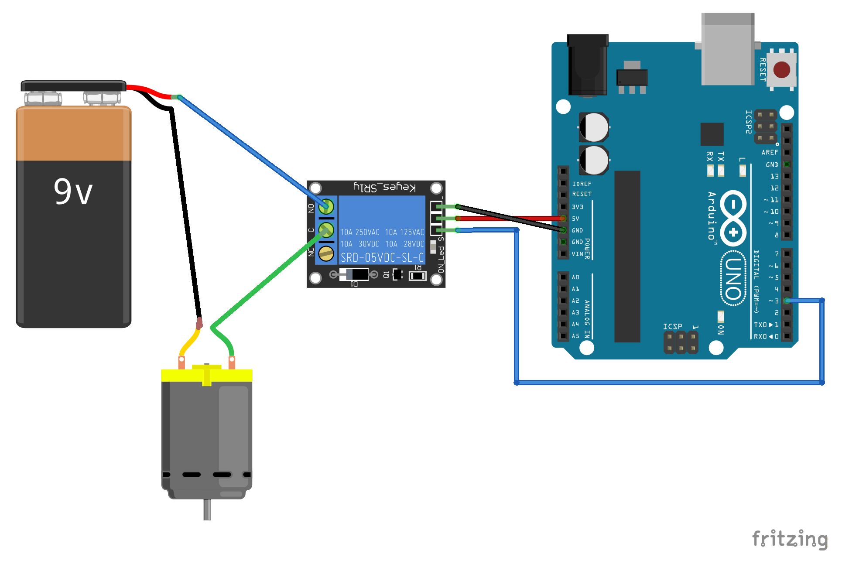
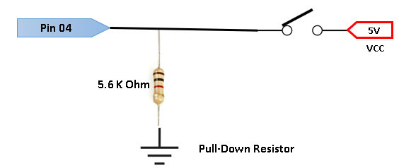
Example Lab8: Arduino with Relay (DC Motor)
Segment #2
Intellectual Property Of CopperCloud IOTech Pvt Ltd

Slide 32
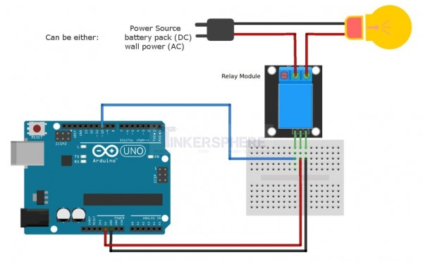
Example Lab9: Arduino with Relay (AC Bulb)
Segment #2
Intellectual Property Of CopperCloud IOTech Pvt Ltd

Slide 33
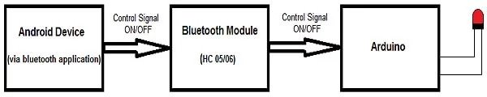

Example Lab10: Arduino Wireless Communication
Segment #2

Slide 34
Extension: Arduino/Wireless control on Relay/Motor from Mobile Phone
Segment #2
Intellectual Property Of CopperCloud IOTech Pvt Ltd

Slide 35
Day 1 (Segments 1 & 2): Q&A
Day 1
Intellectual Property Of CopperCloud IOTech Pvt Ltd

Slide 36
Segment3: Circuit Design & Simulation, PCB Design & Assembly
Day 2
Intellectual Property Of CopperCloud IOTech Pvt Ltd

Slide 37
Logical Flow
Segment #3
Intellectual Property Of CopperCloud IOTech Pvt Ltd

Slide 38

Day2: PCB Design & Build Process
Segment #3
output
Circuit Design & Simulation
Schematic Design
PCB Layout
Gerber files
MULTISIM
PROTEUS
EAGLE
ORCAD
PAD
EXPRESS PCB* (free)
PCB Printing
Review & Test
INDUSTRY TOOLS
VIEWPLOT
Intellectual Property Of CopperCloud IOTech Pvt Ltd

Slide 39

Day2: PCB Design & Build Process
Segment #3
MANUAL SOLDERING
BOTH THROUGH-HOLE & SMD)
PCB Assembly
AUTOMATED ASSEMBLY
(PICK & PLACE SMD)
AUTOMATED ASSEMBLY
(WAVE SOLDERING FOR THROUGH HOLE)
Intellectual Property Of CopperCloud IOTech Pvt Ltd

Slide 40



Day2: PCB Design & Build Process
Segment #3
SMD
Through-Hole
Intellectual Property Of CopperCloud IOTech Pvt Ltd

Slide 41
Day 2 (Segments 3): Q&A
Day 2
Intellectual Property Of CopperCloud IOTech Pvt Ltd

Slide 42
Segment4: Solar Power, Batteries and Power Budgeting
Day 3
Intellectual Property Of CopperCloud IOTech Pvt Ltd

Slide 43
Logical Flow
Segment #4
Intellectual Property Of CopperCloud IOTech Pvt Ltd

Slide 44



Solar Power In India
Segment #4
Average Solar Energy Incident on India:
/Day
Pune:
5.44 kWh/
Intellectual Property Of CopperCloud IOTech Pvt Ltd

Slide 45

Solar Power In India
Segment #4
Intellectual Property Of CopperCloud IOTech Pvt Ltd

Slide 46

Solar Power In India
Segment #4
Intellectual Property Of CopperCloud IOTech Pvt Ltd

Slide 47



Solar Power
Segment #4
Important Specifications:
Intellectual Property Of CopperCloud IOTech Pvt Ltd

Slide 48


Batteries – Types & Specifications
Segment #4
Intellectual Property Of CopperCloud IOTech Pvt Ltd

Slide 49



Purely Solar Powered Circuits
Segment #4
Intellectual Property Of CopperCloud IOTech Pvt Ltd

Slide 50

Purely Solar Powered Circuits
Segment #4
Intellectual Property Of CopperCloud IOTech Pvt Ltd

Slide 51

Solar + Battery Powered Circuits
Segment #4
BATTERY
LOAD
OVER CHARGING
OVER DISCHARGING
Intellectual Property Of CopperCloud IOTech Pvt Ltd

Slide 52

Solar + Battery Powered Circuits
Segment #4
CHARGE CONTROLLER
LOAD
CHARGE PROTECTION
DISCHARGE PROTECTION
BATTERY
Intellectual Property Of CopperCloud IOTech Pvt Ltd

Slide 53


Solar + Battery Powered Circuits – SLA Battery
Segment #4
LOAD
Intellectual Property Of CopperCloud IOTech Pvt Ltd

Slide 54

Solar + Battery Powered Circuits - LIPO
Segment #4
TP 4056
LIPO 18650 (3.7V)
Intellectual Property Of CopperCloud IOTech Pvt Ltd

Slide 55
Power Budgeting: Running Arduino (5V) on Solar Power
Segment #4
5V
3.7V
Intellectual Property Of CopperCloud IOTech Pvt Ltd
Notes:
https://create.arduino.cc/projecthub/igorF2/solar-charged-battery-powered-arduino-uno-645d89

Slide 56

Power Budgeting: Running ESP8266 (3.3V) on Solar Power
Segment #4
3.7V
Intellectual Property Of CopperCloud IOTech Pvt Ltd
Notes:
https://create.arduino.cc/projecthub/igorF2/solar-charged-battery-powered-arduino-uno-645d89

Slide 57

Power Budgeting
Segment #4
Power Budget Example
In Sleep Mode
Average Current Draw = 50 mA
5 mA
120 mAH
20 mA +20%
Average Power Requirement= V*I = 3.3V * 50mA = 165 mW
Required Battery Capacity = 50mA * 24 = 1200 mAH
Solar Panel Capacity Required = 1200 mAH / 6 hours
= 200 mA current capacity + 20%
Intellectual Property Of CopperCloud IOTech Pvt Ltd
Notes:
https://create.arduino.cc/projecthub/igorF2/solar-charged-battery-powered-arduino-uno-645d89

Slide 58
Example Lab 12: Running ESP8266 (3.3V) on Solar Power
Segment #4
Intellectual Property Of CopperCloud IOTech Pvt Ltd
Notes:
https://create.arduino.cc/projecthub/igorF2/solar-charged-battery-powered-arduino-uno-645d89

Slide 59


Segment #4
Example Lab 13 (Extra): Send Daylight Data to ThingSpeak
Intellectual Property Of CopperCloud IOTech Pvt Ltd

Slide 60
Instructors’ Manual
Intellectual Property Of CopperCloud IOTech Pvt Ltd

Slide 61
Let’s Review All Practicals …
Intellectual Property Of CopperCloud IOTech Pvt Ltd

Slide 62
But let’s talk about Feedback first!
Intellectual Property Of CopperCloud IOTech Pvt Ltd

Slide 63

CopperCloud Educational Offerings
Short-Term Engagements
Seminars
Workshops
FDPs
Guest Lectures
IoT Hardware Kits
Medium-Term Engagements
Set up IoT infra/Lab
Internships
Mentoring BE Projects
Add-on IoT Course( 6 months)
Long-Term Engagements
Centre of Excellence (IoT)
BE (Hons) with Specialization IoT
B.Voc/D.Voc Vocational Courses
Intellectual Property Of CopperCloud IOTech Pvt Ltd

Slide 64
Driving Principles
Intensive Practical Orientation
Industry Tools and Practices Interwoven throughout the courses
Industry- readiness
Courses designed for multi-disciplinary skills
Preference for real Industry equipment, rather than “ready to use” kits
Intellectual Property Of CopperCloud IOTech Pvt Ltd

Slide 65


Breaking Barriers to Emerging Technology
Barriers
Concerns about Programming Skills
Fear of failure
Steep learning curve for emergent technologies
Too much info, changing too fast
“Drop-out” rate is high
Little to no direct interaction of students outside their “echo chambers”
“No-Code” or “Low-Code” Tooling Ecosystem
1
2
Agile
There needs to be a concerted effort to address these barriers
3
Simplify the
Learning Curve
Intellectual Property Of CopperCloud IOTech Pvt Ltd

Slide 66
IoT & Emergent technology Workshops
3 days
8 hours a day
Batch size upto 30
Predominantly hands-on
Workshops
Technology Service Provider
Technology Consumers
Intensely Hands-on (12 exercises)
Catalyst for driving Industry4.0
8 Industry Standard Tools
ID Opportunities & Evaluate Options
Full-fledged IoT Solution on Day 3
Know the tech capabilities
Exact same level of training
as our new team members
Negotiate with Service Providers
Intellectual Property Of CopperCloud IOTech Pvt Ltd

Slide 67

Training Attendees: Distribution so far (all formats)
Intellectual Property Of CopperCloud IOTech Pvt Ltd

Slide 68


Consolidated Feedback (all formats)
5 = Excellent; 4 = Good; 3 = Satisfactory; 2 & 1 = Poor
Intellectual Property Of CopperCloud IOTech Pvt Ltd

Slide 69
Review of Recommended Practical Labs
Intellectual Property Of CopperCloud IOTech Pvt Ltd

Slide 70

Thank You
iot@coppercloud.in
+91 77980 32613
Intellectual Property Of CopperCloud IOTech Pvt Ltd
Notes:
https://join.freeconferencecall.com/abhijeetdeogirikar

